Slide 1
Rural Housing Service
Committed to the Future of Rural Communities

Slide 2
USDA Rural Development Virginia Clean Cities-Drive Clean
Perry Hickman,
Virginia Rural Development State Director
Barbara Hodges,
Virginia Rural Development Acting Community Programs Director, Community Facilities
Richmond, Virginia
April 19, 2022

Slide 3
Rural Development (RD) - Community Facilities
Community Facilities (CF)
The Community Facilities program has a long and proud history of providing financial assistance to rural communities to enhance the quality of life in rural America.
These investments in rural America help to ensure that our rural communities are repopulating, self-sustaining and thriving economically.
As of April 13, 2022, Nationally the CF portfolio includes over $12.5 billion in Direct and Guaranteed Loan unpaid principal and Grants advances.

Slide 4
Rural Development (RD) - Community Facilities
Community Facilities (CF)
This program provides affordable funding to develop essential community facilities or to improve community infrastructure and essential community facilities for public use in rural areas.
CF Direct Loan Program Virginia FY 21 Allocation $55 million
CF Guaranteed Loan Program Virginia FY 21 Allocation $5 million
CF Regular Grant Program Virginia FY 21 Allocation $775 thousand

Slide 5
Rural Development (RD) - Community Facilities
CF Direct Loan Program

Slide 6
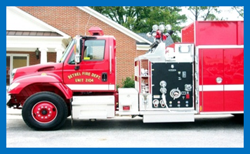
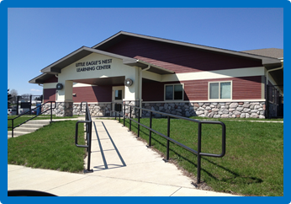
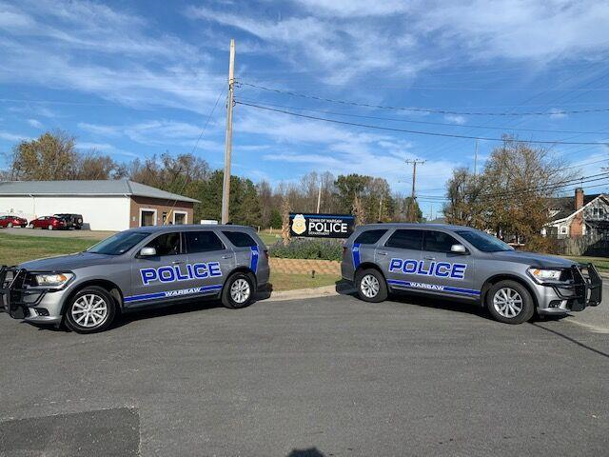
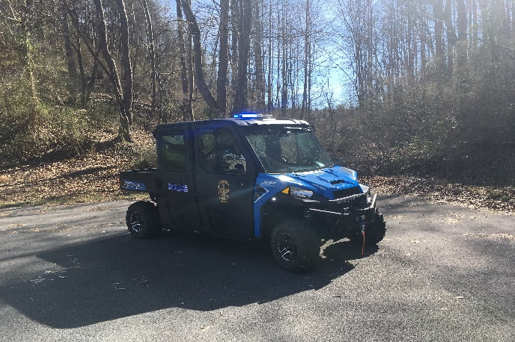
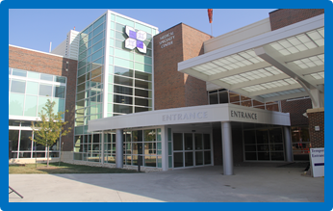
Rural Development (RD) - Community Facilities
Essential Community Facilities
Public Safety Facilities & Equipment
Public Buildings & Equipment
Health Care Facilities & Equipment
Education & Cultural Facilities & Equipment
Infrastructure

Slide 7
Rural Development (RD) - Community Facilities
Eligible Rural Areas
Cities, towns, and census designated places (CDPs) with populations of 20,000 or less according to the latest decennial census of the United States.
No limitation on population in unincorporated rural areas except in CDPs.

Slide 8
Rural Development (RD) - Community Facilities
Eligible Entities
Public Bodies
Community-based not-for-profit corporations
Federally recognized Tribes

Slide 9
Rural Development (RD) - Community Facilities
Eligible Loan Purposes
Purchase vehicles and major equipment
Acquire existing real estate
Construct, expand, renovate, or improve facilities
Associated project expenses (i.e., legal fees, interest expense)
Refinancing when it’s less than 50% of the total project cost

Slide 10
Rural Development (RD) - Community Facilities
Partial listing of Law Enforcement Projects funded with CF Funds include:
Equipment
Police Vehicles (including electric vehicles and charging stations)
Rescue and Recovery vehicles
Car and Body Cameras
Ballistic Vests
Construction Projects
Detention Centers
Training Centers
Administrative Buildings
Courthouses

Slide 11
Community Facilities
Collateral
Borrowers must pledge sufficient assets to ensure repayment of the loan. The security may include any combination of the following: real estate, machinery & equipment, assured income, or accounts receivable.
Procurement
Borrowers must competitively bid projects to ensure maximum open and free competition.

Slide 12
Community Facilities
Repayment Terms
Real Estate
The remaining economic life of the facility
Not to exceed 40 years
Equipment
Life expectancy of the equipment
Interest Rate
2.50% as of April 1, 2022

Slide 13
Community Facilities
Additional Requirements
Facility must serve rural area.
Legal authority to borrow money.
Applicants must be unable to finance the project.
Demonstrate substantial community support.

Slide 14
Rural Development (RD) - Community Facilities
CF Regular Grant Program

Slide 15
Rural Development (RD) - Community Facilities
CF Regular Grant Program
Eligible Entities
Same criteria as the Direct Loan Program
Eligible Grant Purpose
Purchase Vehicles and Equipment
Grant Determination
Based on the Service Area Median Household Income (15% to 75% of project cost not to exceed $50K)
Financial Capacity of the Applicant to Repay a Loan

Slide 16
Rural Development (RD) - Community Facilities
National Office
Headquarters located in Washington DC | CP Deputy Administrator and staff
State Offices
Located in 47 states | RD State Director and staff
Area Offices
Virginia has 4 Area Offices and 4 Sub-Area Offices

Slide 17
Rural Development (RD) - Community Facilities
Area 1 serves you locally from our Lebanon Virginia Sub-Office
USDA Service Center-Lebanon Robert Hilt, Community Programs Area Specialist
140 Highland Drive, Suite 5 Lebanon, Virginia
Lebanon, VA 24266-4632 (276) 415-3522
USDA Service Center-Lebanon Jason Harter, Community Programs Area Specialist
140 Highland Drive, Suite 5 Lebanon, Virginia
Lebanon, VA 24266-4632 (276) 415-3521
USDA Service Center-Wytheville Craig Barbrow, Area Director
100 USDA Drive Wytheville, Virginia
Wytheville, VA 24381-8366 (276) 484-9384

Slide 18
Rural Development (RD) - Community Facilities
Area 2 serves you locally from our Lynchburg Area Office
USDA Service Center-Lynchburg Cindy Bomar, Community Programs Area Specialist
20311-A Timberlake Road Lynchburg, Virginia
Lynchburg, VA 24502 (434) 439-3589
USDA Service Center-Lynchburg David Worley, Area Director
20311-A Timberlake Road Lynchburg, Virginia
Lynchburg, VA 24502 (804) 382-4527

Slide 19
Rural Development (RD) - Community Facilities
Area 3 serves you locally from our Harrisonburg Area Office or the Culpeper Sub-Office
USDA Service Center-Harrisonburg Cindy Hines, Community Programs Area Specialist
1934 Deyerle Ave, Suite D Harrisonburg, Virginia
Harrisonburg, VA 22801 (540) 534-3060
USDA Service Center-Culpeper Daniel Wanamaker, Community Programs Area Specialist
351 Lakeside Drive Culpeper, Virginia
Culpeper, VA 22701 (540) 317-7734
USDA Service Center-Harrisonburg Steven Davis, Area Director
1934 Deyerle Ave, Suite D Harrisonburg, Virginia
Harrisonburg, VA 22801 (540) 534-3064

Slide 20
Rural Development (RD) - Community Facilities
Area 4 serves you locally from our Courtland Area Office or the Richmond Sub-Office
USDA Service Center-Courtland Peggy Jordan, Community Programs Area Specialist
22329 Main Street Courtland, Virginia
Courtland, VA 23837 (757) 346-3158
USDA Richmond State Office Tara Delaney, Community Programs Area Specialist
1606 Santa Rosa Road, Suite 238 Richmond, Virginia
Richmond, VA 23229 (804) 287-1599
USDA Service Center-Courtland Myron Wooden, Area Director
22329 Main Street Courtland, Virginia
Courtland, VA 23837 (757) 346-3162

Slide 21
Questions
Perry Hickman,
Virginia Rural Development State Director
Barbara Hodges,
Virginia Rural Development Acting Community Programs Director, Community Facilities

